Slide 1
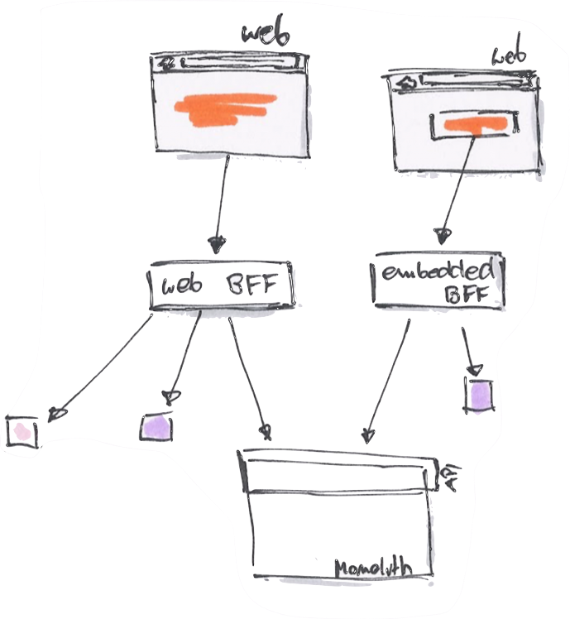
Backends For Frontends
By Luis Atencio (@luijar)

Slide 2
In brief:
PHP7
Functional programming
Reactive programming
Docker
Service orchestration

Slide 3


About me...
Cloud Engineer @ Citrix Systems
10+ years architecting web apps using PHP, JavaScript, and Java
Author
Speaker
luisatencio.net

Slide 6
Around 2000s...
Asynchronous
Declarative
Fluent
Unidirectional
Easy?
Business Process
Execution Language (BPEL)

Slide 7

Back to the present...
Essential pattern for architectures with a large number of services
Need to aggregate multiple downstream calls to deliver user functionality
Single Backend-for-Frontend can result in multiple calls to microservices

Slide 8
A Backend-for-Frontend (BFF) is a pattern for designing
API backends to aggregate multiple (scattered)
downstream services

Slide 9
What is the “right” pattern for this?

Slide 11
Introducing your new BFF
Reactive Extensions for PHP (RxPHP)
https://github.com/ReactiveX/RxPHP

Slide 12
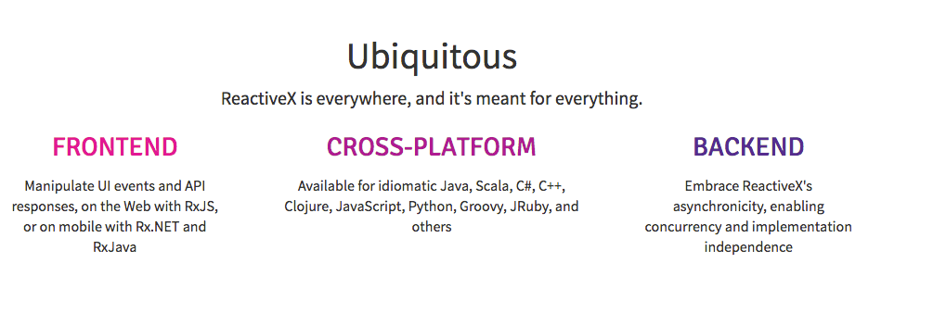

Slide 13
RxPHP can:
Process any type of data source
Work on synchronous as well as asynchronous data
Handle 1 or infinitely many values
Bend time
Built-in debouncing/throttling
Built-in error handling and retries

Slide 14
Data in
Data out
Producer
Observable
Consumer

Slide 15
RxPHP is a functional library to compose asynchronous
and event-based programs using observable collections
and LINQ-style query operators in PHP.
- https://github.com/ReactiveX/RxPHP

Slide 18
PHP = PHunctional Programming

Slide 19
Observables are functional
Immutable
Lazily evaluated
Handle 1 or infinitely many values
Push not pull
Pure
Declarative
Monadic wt*???

Slide 20
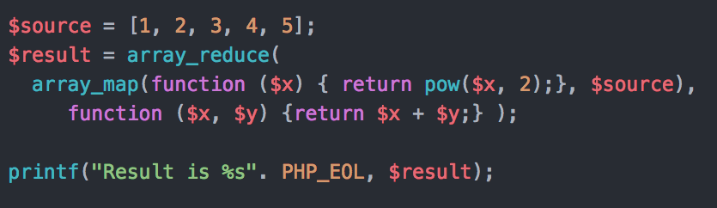

Slide 21
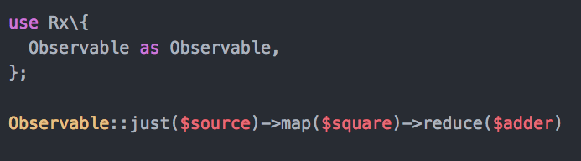
Observables are mappable

Slide 22
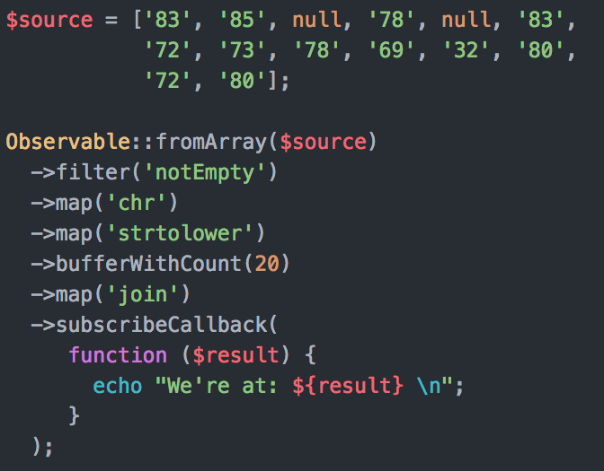
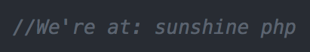
Asynchronous
Declarative
Fluent
Unidirectional
Easy

Slide 23
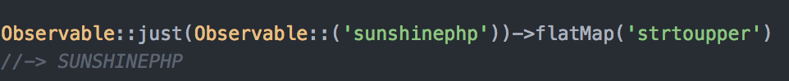
Observables are nestable

Slide 24
Observables are monadic!!
Unit function: just(), from(), of(), ...
Mapping: map()
Bind operator: flatMap()

Slide 25
Observables are chainable
Use map() to apply a “pure function” to your flow
Use flatMap() to apply other “pure observables” to your flow

Slide 26
Apply pure function
Hello!
upper
unwrap
wrap
Observable
Observable
Observable
map
Hello!
HELLO!

Slide 27
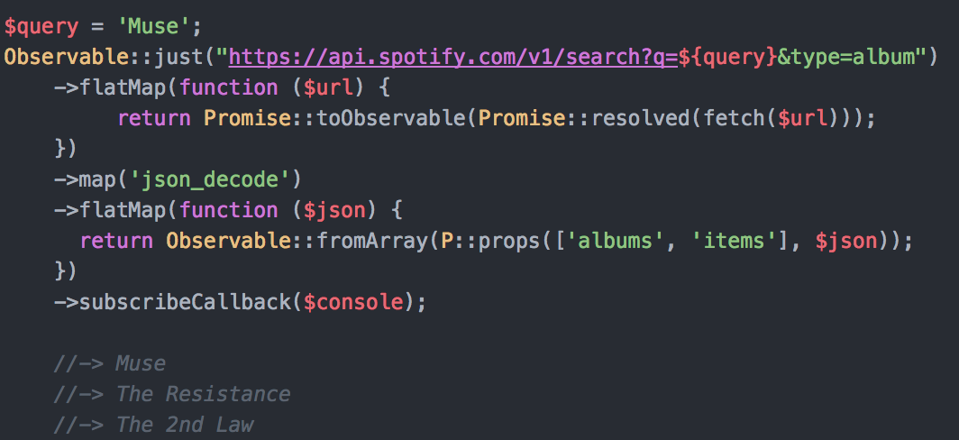

Slide 29
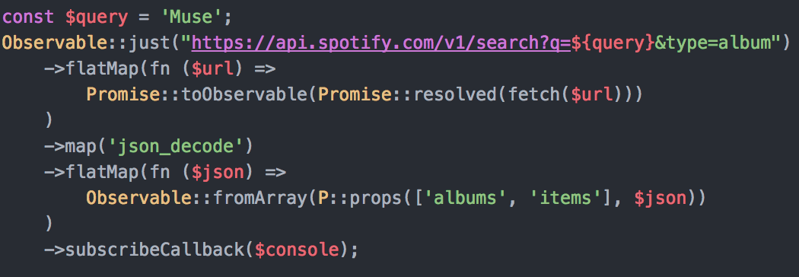
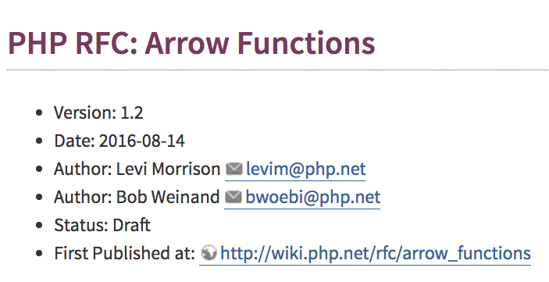
Later 2017?

Slide 30
DEMO

Slide 31
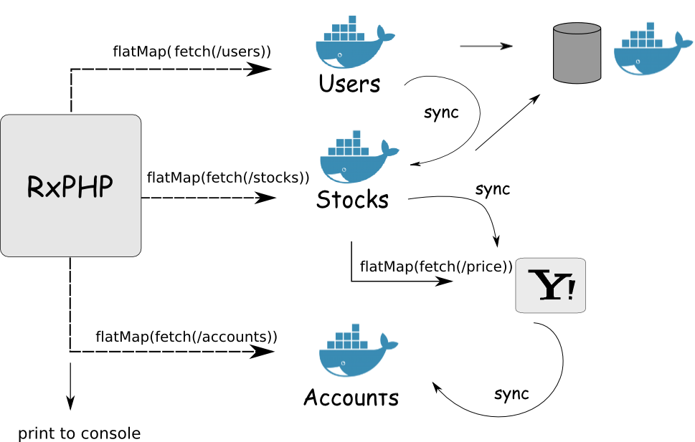


Slide 32
docker-compose
+

Slide 33

To reduce()...
RxPHP is your BFF (Backend for Frontend)
to tackle all of your async needs

Slide 34

Resources
Functional Programming in JavaScript
Visit: http://bit.ly/1Vibblv
discount: 39atencio
RxJS in Action
Visit: http://bit.ly/rxjsinaction
discount: 39daniels
Functional PHP
Visit: https://leanpub.com/functional-php
Free!
In progress

Slide 35
Functional Programming with PHP7
Pure Functions
Composition
Lazy evaluation
Closures
etc....
Link: http://bit.ly/fp-php7
-50% promo Code: VIDFPHP7

Slide 36
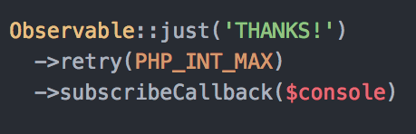
@luijar
https://joind.in/talk/1bfa7

